Slide 1
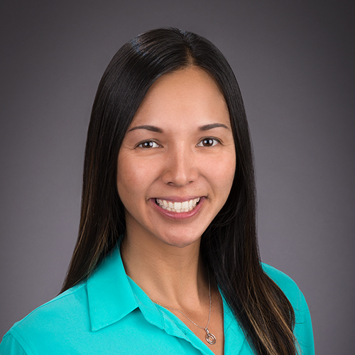
“My grandma never had a mammogram. At age 67 she was diagnosed with Stage IV Breast Cancer. She died 6 months after her diagnosis. The hardest thing in life was watching the strong matriarch of our family rapidly decline.
Education and outreach saves lives, but funding is necessary to accomplish that, which is what drives my dedication to Komen.”
Flora Hoan, Komen San Diego Development Director, Top Fundraiser

